Slide 1
Lead Scoring Case Study using logistic regression model
Submitted by :
Vinod Yadav
Vignesh Kumar
Ujjwal Verma

Slide 2
Outline
Executive Summary
Introduction
Methodology
Results
Conclusion

Slide 3
Executive Summary
Summary of methodologies
Data Collection
Exploratory Data Analysis
Identifying Categorical Variables and Creating Dummy Variables
Model Building Using Logistic Regression
Prediction on Test Dataset
Conclusion
Summary of results
Data Analysis along with Interactive Visualizations
Conclusion and recommendations

Slide 4
introduction
Case study background
An education company named X Education sells online courses to industry professionals. On any given day, many professionals who are interested in the courses land on their website and browse for courses.
Company markets its courses on several websites and search engines like Google. Once these people land on the website, they might browse the courses or fill up a form for the course or watch some videos. When these people fill up a form providing their email address or phone number, they are classified to be a lead. Moreover, the company also gets leads through past referrals. Once these leads are acquired, employees from the sales team start making calls, writing emails, etc. Through this process, some of the leads get converted while most do not. The typical lead conversion rate at X education is around 30%.
Although X Education gets a lot of leads, its lead conversion rate is very poor. For example, if, say, they acquire 100 leads in a day, only about 30 of them are converted. To make this process more efficient, the company wishes to identify the most potential leads, also known as ‘Hot Leads’. If they successfully identify this set of leads, the lead conversion rate should go up as the sales team will now be focusing more on communicating with the potential leads rather than making calls to everyone.

Slide 5
introduction
Goals of the Case Study:
To build a logistic regression model to assign a lead score between 0 and 100 to each of the leads which can be used by the company to target potential leads.
To adjust to if the company's requirement changes in the future so you will need to handle these as well.

Slide 6
Methodology
Goals of the Case Study:
Data Preprocessing
Data Visualization
Model Training
Model Testings
Metrics Comparison
Conclusion

Slide 7
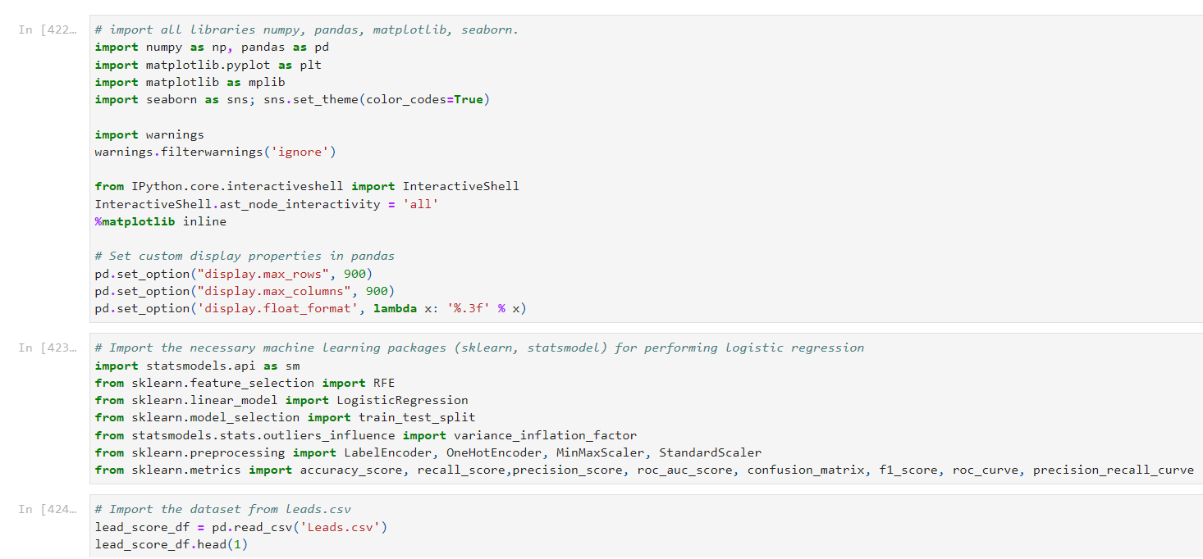
Data Preprocessing
1. Package Imports and Data Initialization

Slide 8
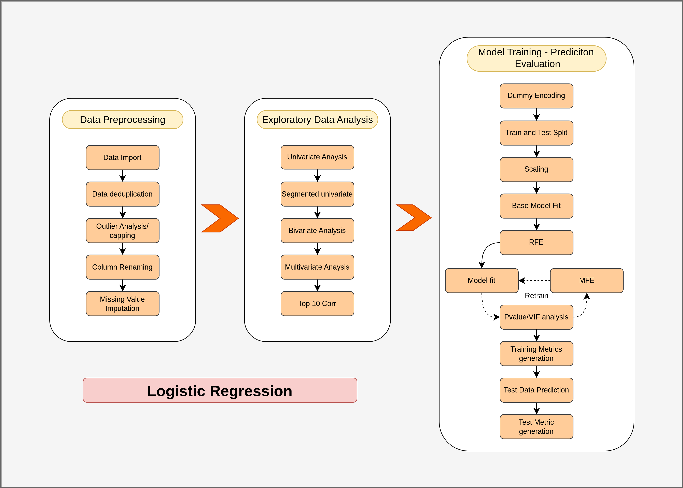
Data Preprocessing - Part 1
Steps in logistic regression model

Slide 9

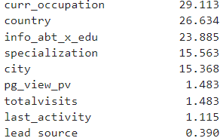
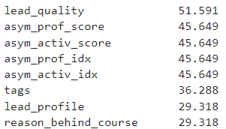
Data Preprocessing
#We have created Custom Functions for Preprocessing and EDA
def classify_feature_dtype(df, cols):
def show_stats(df, cols):
def check_cols_null_pct(df):
def univariate_plots(df, cols, target=None, ftype=None, l_dict = None):
def get_extremeval_threshld(df, find_outlier=False)
# With the below mentioned code we have drop unnecessary columns
#below mentioned code will give us the shape and size of the data frame
# With the below mentioned code we have# checked null val percentage
# After checking the null value percentage for all the features
# We could see that there are many features that have more than 45% of non values

Slide 10
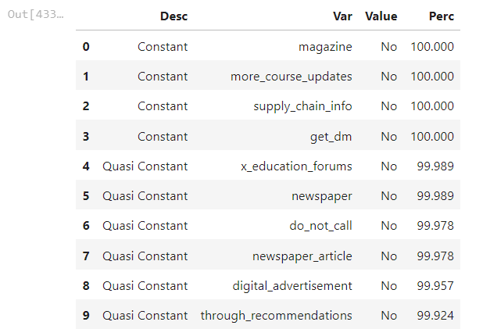
Data Preprocessing
Below mentioned code has replace select string with nan
#We have Constant Feature Identification

Slide 11
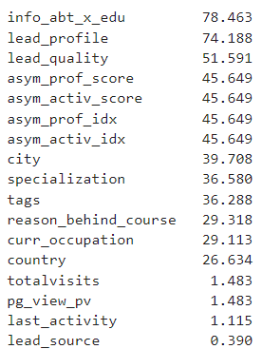
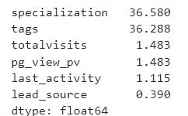
Data Preprocessing
#check null val percentage ,
# Since we have replaced select as null value for certain columns we are seeing increase in the null value percentage for those features
# Therefore we dropped all the features that have more than 40 of null values
# Now there are only two columns that have more than 36 off missing values tags and specialization

Slide 12
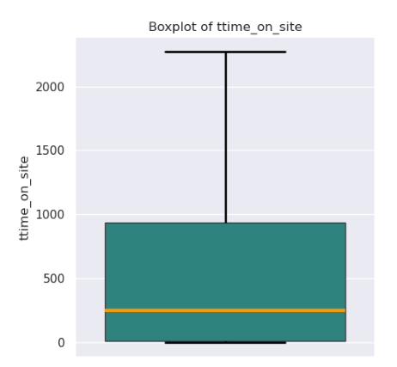
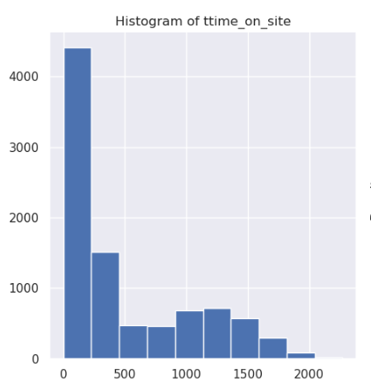
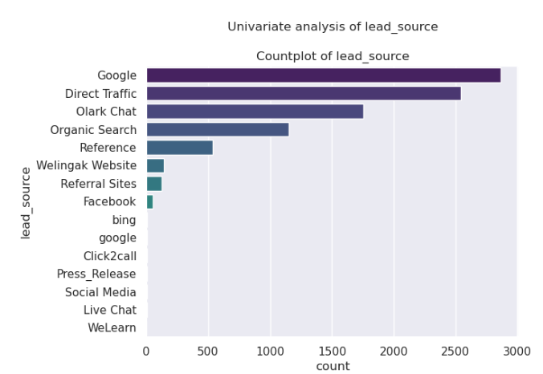
Data Visualization
univariate plots

Slide 13
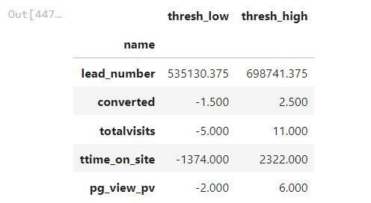
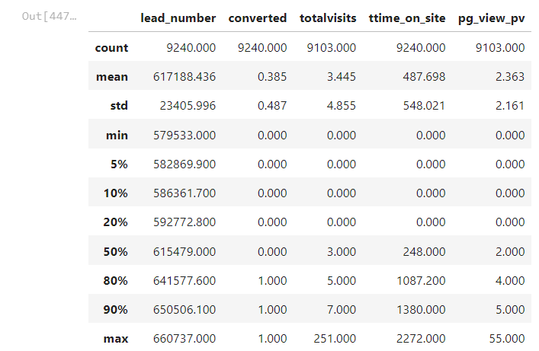
Data preprocessing part 2
Outlier Analysis and Capping

Slide 14

Data preprocessing part 2
there are few null values in their total visits and page view pub features therefore we replace with the mean of that particular column
our null values have significantly reduced
Data Imbalance & Conversion Ratio
# From the target variable we have found out the imbalance ratios around 62 therefore we decide not to rebalance

Slide 15
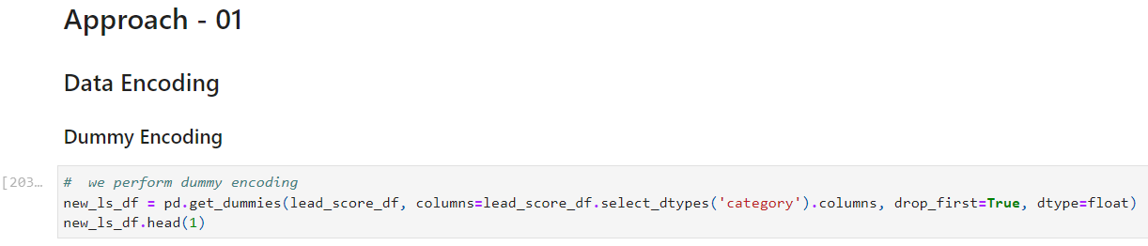
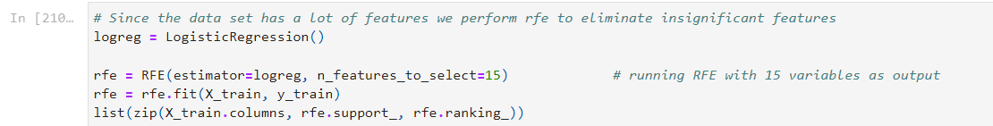
Data preprocessing part 2
we have performed dummy encoding
we have used custom functions for model training
RFE - Recursive Feature Elimination

Slide 16
TRADING & INVESTING
Crypto can be complicated but getting started doesn’t have to be

Slide 17
LONG-TERM VS. SHORT-TERM

Slide 18
GLOBAL CURRENCY MARKETS
 | $USD | £EUR | ¥JPY | ₿BTC
Q1 | 4.5 | 2.3 | 1.7 | 5.0
Q2 | 3.2 | 5.1 | 4.4 | 3.0
Q3 | 2.1 | 1.7 | 2.5 | 2.8
Q4 | 4.5 | 2.2 | 1.7 | 7.0

Slide 19
WEALTH IS THE ABILITY TO FULLY EXPERIENCE LIFE.
-Henry David Thoreau

Slide 20
TYPES OF TOKENS
Payment
Utility
Security
NFT
Gaming
Used to complete transactions anywhere crypto is accepted
These tokens have a specific use within a blockchain
Tokens backed by securities
Authenticates ownership of specific assets
Used as in-game currency and traded with real world value

Slide 21





PORTFOLIO BUILDUP
Step 1
Step 2
Step 3
Step 4
Step 5
Choose a cryptocurrency exchange
Purchase preferred coins & create "wallet"
Research investment and trading options
Stake preferred coins in chosen company
Set exponential growth goals

Slide 22
AREAS OF FOCUS
Portfolio diversification
Short and long-term goals
Develop winning combinations to stay ahead of the market
Capitalize on direct ownership of digital coins
Invest in multiple blockchains​
Create an emergency fund
Add a second stream of income
Buy a house
Supplement retirement fund

Slide 23
HOW TO GET THERE
Strategize
Minimize risk
Utilize resources
Do your research and develop a plan with goals
Diversify your portfolio through coin ownership​
Follow the markets closely​
Be cautious of scams and "too good to be true" scenarios
Avoid "all-in" strategies
Apps and platforms help streamline user experience
Seek expert guidance from Krypto Logics team members​

Slide 24

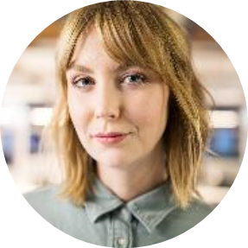


MEET OUR TEAM
Takuma Hayashi​
Mirjam Nilsson​
Flora Berggren​
Rajesh Santoshi​
President
Chief Executive Officer
Chief Operations Officer
VP Marketing

Slide 25




MEET OUR EXTENDED TEAM
Takuma Hayashi​
Mirjam Nilsson​
Flora Berggren​
Rajesh Santoshi​
President
Chief Executive Officer
Chief Operations Officer
VP Marketing
Graham Barnes
Rowan Murphy
Elizabeth Moore
Robin Kline
VP Product
SEO Strategist
Product Designer
Content Developer

Slide 26
SUMMARY
At Krypto Logics, we believe in giving 110%. By using our next-generation data architecture, we help investors virtually manage their portfolios. We thrive because of our market knowledge and great team. As our CEO says, "Efficiencies will come from proactively transforming how we do business."

Slide 27
THANK YOU
Mirjam Nilsson​
mirjam@greatsiteaddress.com
www.greatsiteaddress.com

